Slide 1
BIRDS-5
Weekly Update for Communication, S&F, and Antenna Subsystems
Anechoic Chamber Test
07-January-2021
Ramson Nyamukondiwa
Edgar Mujuni

Slide 2
Outline
Antenna Tuning
Antenna Radiation Pattern
Sensitivity Testing

Slide 3
Test1: Antenna Tuning=> S11 Parameters
Three 1U satellites and one 2U satellite
Results in dB log curve and Smith Chat
Calibration UHF (435-438 MHz)
Calibration VHF (144-146MHz)

Slide 4
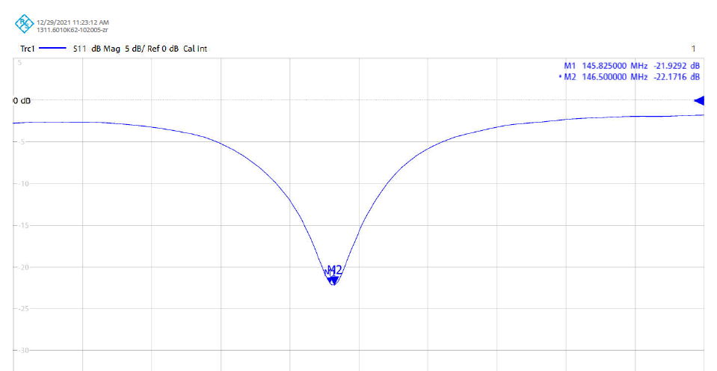
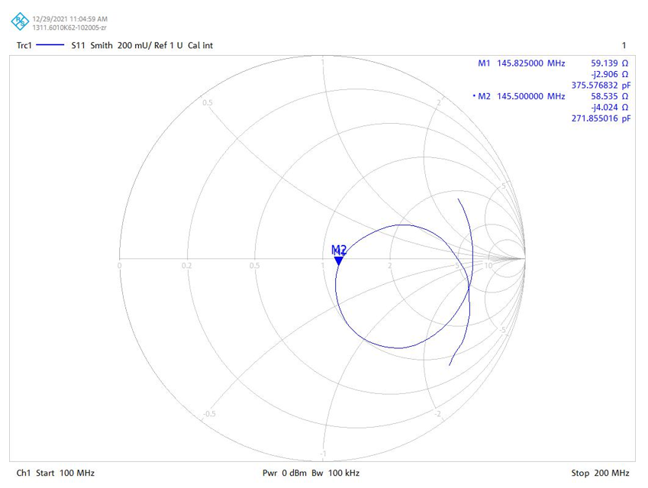
VHF S-Parameter 1U Sat1
S11: -21.9 dB
Freq : 145.825 MHz
Length: 498 mm

Slide 5
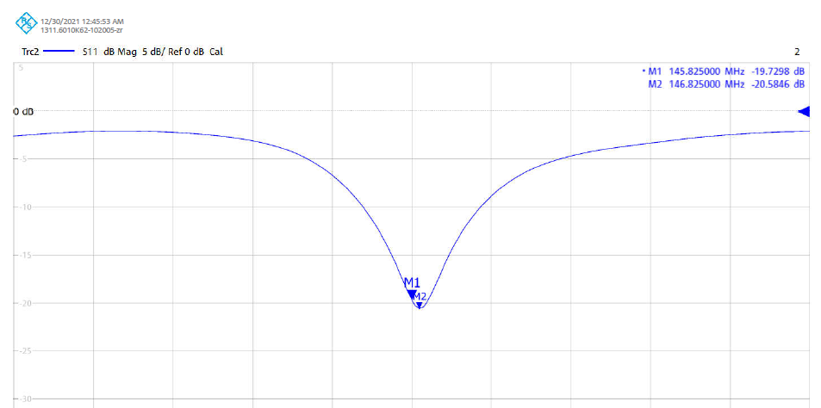
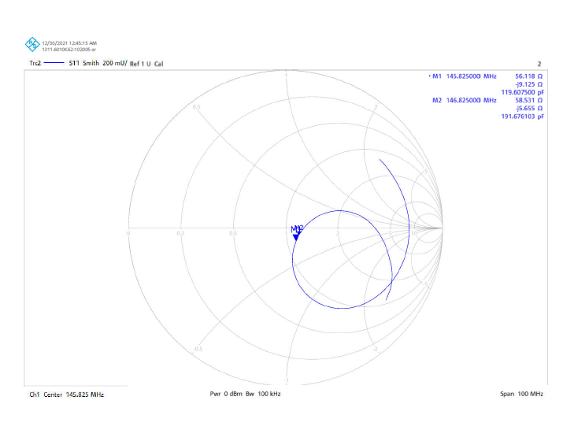
VHF S-parameter 1U Sat2
S11: -19.7dB
Freq: 145.825MHz

Slide 6
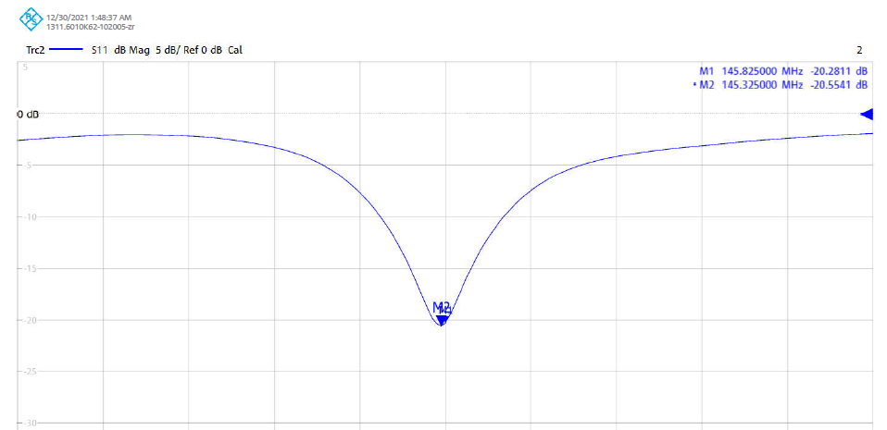
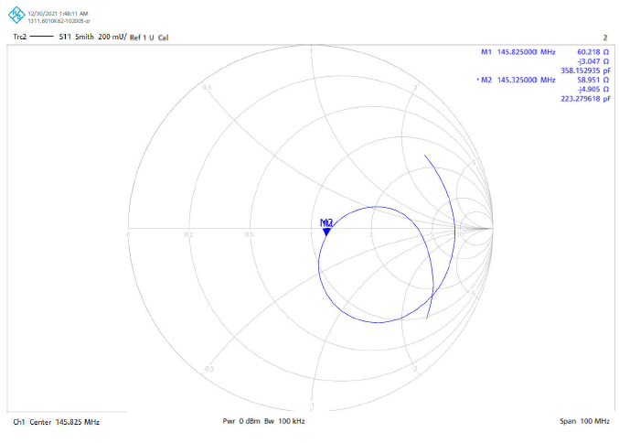
VHF S-parameter 1U Sat3
S11 – -20.3dB
Freq – 145.825MHz

Slide 7
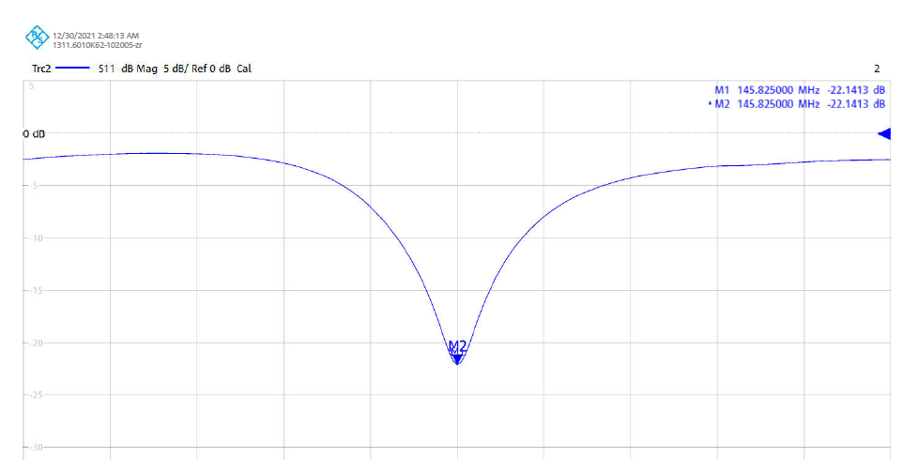
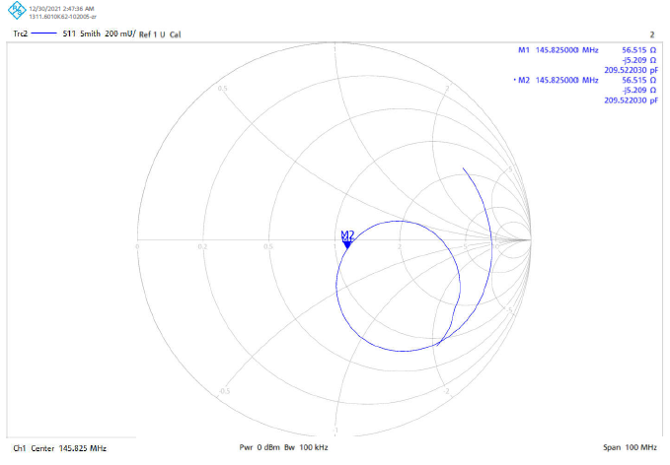
VHF S-parameter Sat4: 2U
S11 – -22.1dB
Freq – 145.825MHz

Slide 8
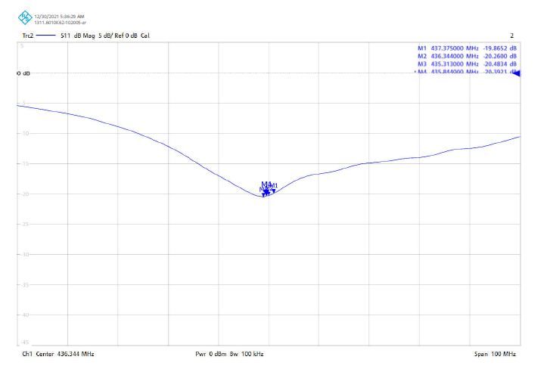
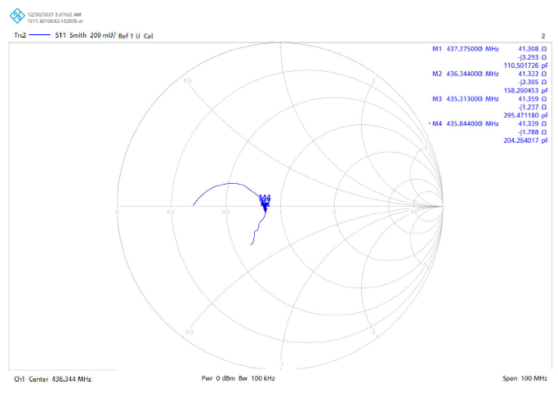
UHF S-parameter 1U Sat1
S11 – -20.2dB
Freq – 436.344MHz
Length - 193mm

Slide 9
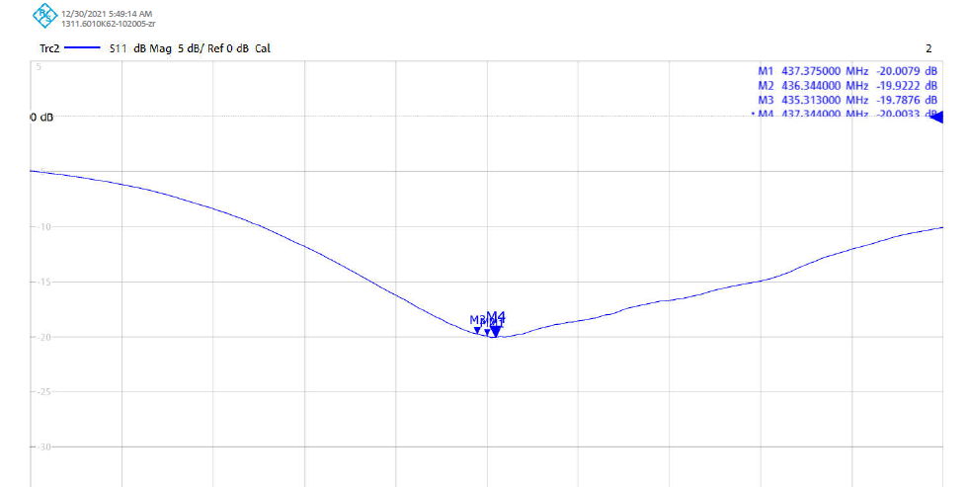
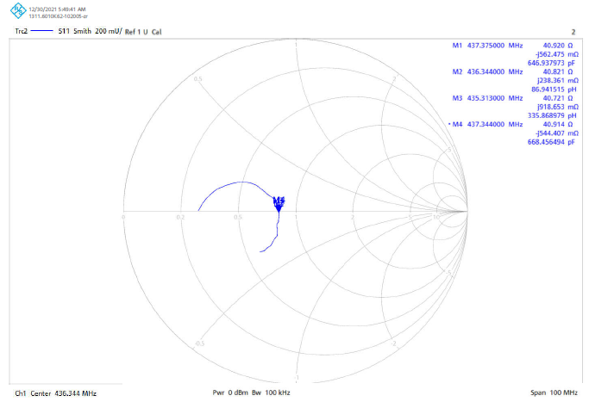
UHF S-parameter 1U Sat2
S11 – -19.9dB
Freq – 436.344MHz

Slide 10
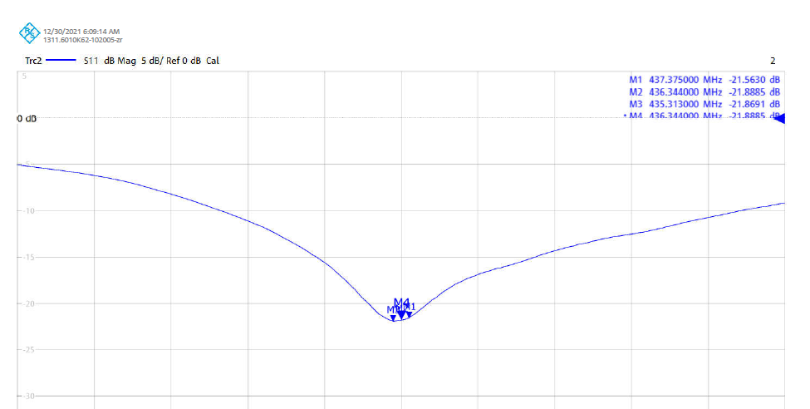
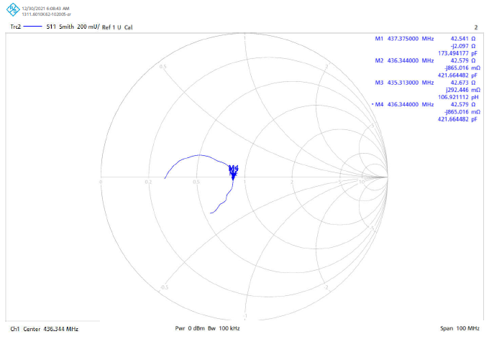
UHF S-parameter 1U Sat3
S11 – -21.8dB
Freq – 436.344MHz

Slide 11
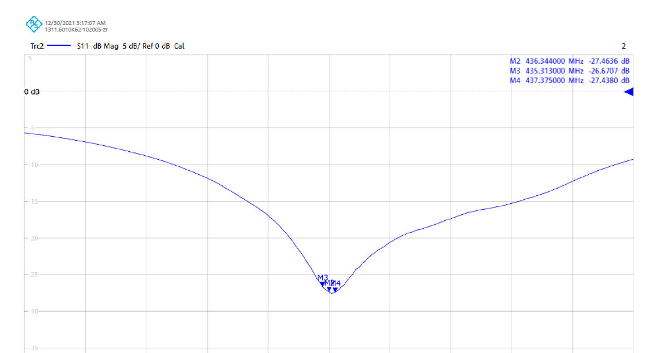
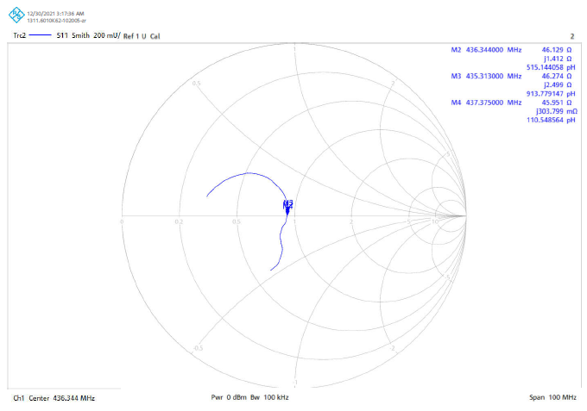
UHF S-parameter Sat4: 2U
S11 – -26.4dB
Freq – 436.344MHz

Slide 12
Test – 2 : Measuring Dipole Antenna Radiation Pattern
One 1U and one 2U
UHF and VHF antenna pattern :
E and H planes
Determine the antenna gain

Slide 13
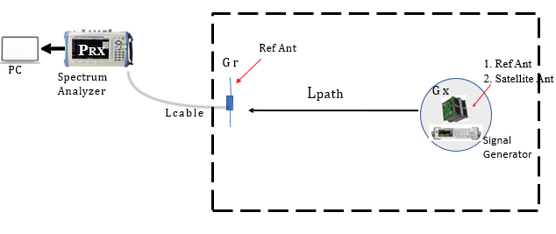
Radiation Pattern Measurement procedure
Measure all the cable losses for each frequency (145MHz & 437MHz)
Calculate ideal Path Loss at 3.71m
Measure the path loss from Spectrum Analyzer reading using Ref. Antenna
Compare the path loss results & confirm them to be almost equal.
Conduct Radiation patten measurement of Ref Antenna (G_{max} should be around 2.2dBi)
Replace Reference Antenna with Satellite antenna (Satellite)
Conduct Radiation pattern measurement of Satellite Antenna.

Slide 14
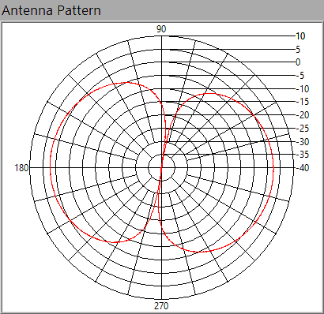
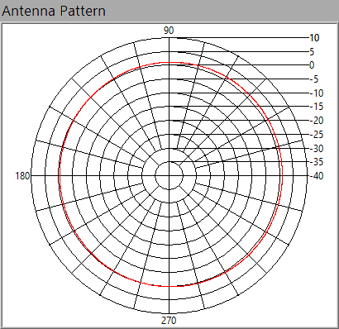
VHF Reference Antenna
E-plane
H-plane
G_{max} – 2.4dBi

Slide 15
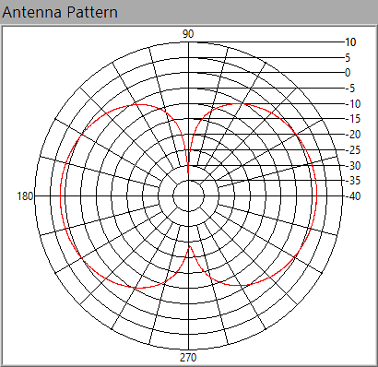
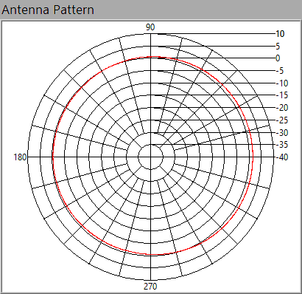
VHF 1U – Sat1
E-plane
H-plane
G_{max} – 1.4dBi

Slide 16
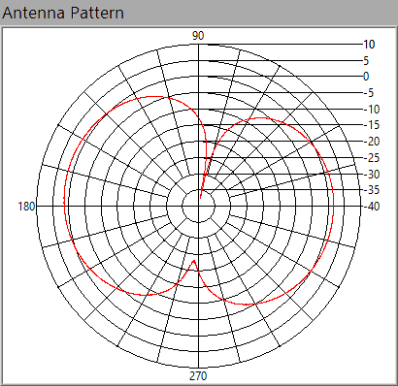
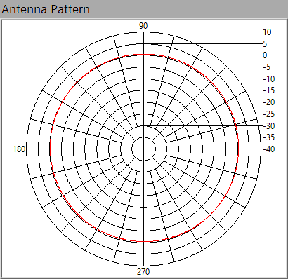
VHF 2U Sat4
E-plane
H-plane
G_{max} – 1.6dBi

Slide 17
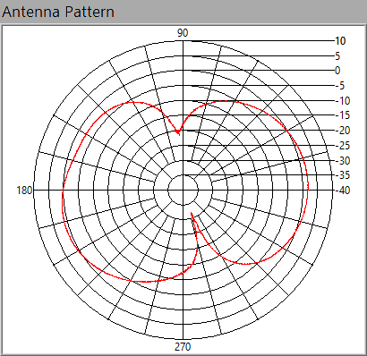
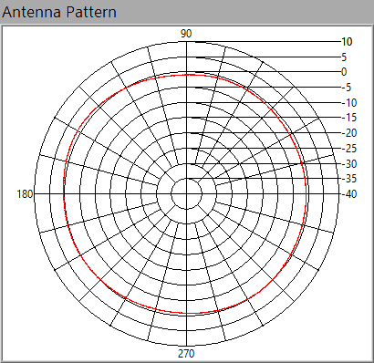
UHF 1U - Sat 1
E-plane
H-plane
G_{max} – 1.9dBi

Slide 18
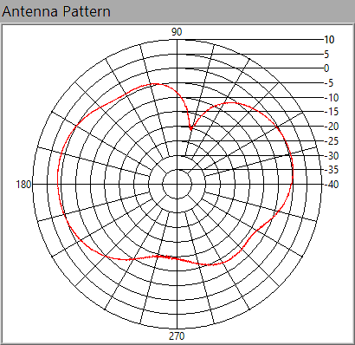
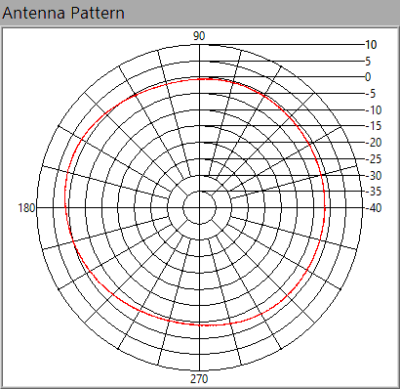
UHF Sat4: 2U
E-plane
H-plane
G_{max} : 1.8dBi

Slide 19
Test – 3 : Measuring TRX Sensitivity
UHF Transceiver Sensitivity=>ADD1397BF
VHF Transceiver Sensitivity => BiM1H
Preparations
Battery Voltage
CW and FM Output Power

Slide 20
Test – 3 : Measuring TRX Sensitivity
Calibration
Measure cable loses in Up and Downlink
Measuring the ICOM radio transmission power
Determine the practical antenna gains of
Ref Antenna and BIRDS antenna
Determine the path loss for Up and Downlink
Measure received power at the antenna
Uplink success rate

Slide 21
Summary of Measured Output Power
Satellites and Transceivers Used | Battery Voltage (V) | CW TX Output (dBm) | FM TX Output (dBm)
Satellite1 Transceiver 1: New | 4.1 | 25.3 | 28.8
Satellite 2 Transceiver 2: BIRDS4 | 4.1 | -17.1 | -30.0
Satellite 3 Transceiver 3: BIRDS3 | 4.1 | 20.8 | 28.7
Satellite 4 Transceiver 4: 2U Only | 4.0 | 20.2 | 28.8
FM and CW output were measured with power meter

Slide 22
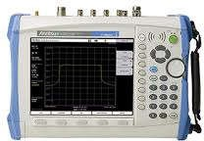

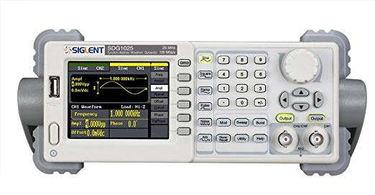



Calibration-UHF
Radio Transmission Output
$$P_{RX}=P_{TX}−Att=−6.7dBm$$
39 dB
Attenuator
Spectrum analyzer
ICOM-9100 Radio
2. Cable Loss
$$L_{C}=5.8dB$$
$$L_{C}$$
Signal Generator
Spectrum analyzer
3. Attenuator Functionality Checked
Variable Attenuations
Only verified Attenuators were used

Slide 23


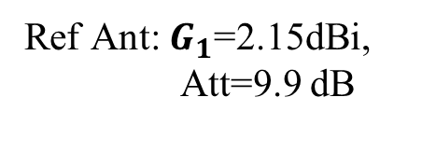





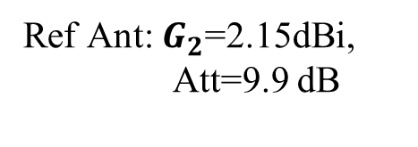
Determining the Path Loss
Practical Path Loss
Ref Ant: $G_{1}$=2.15dBi,
Att=9.9 dB
Ref Ant: $G_{2}$=2.15dBi,
Att=9.9 dB
$$d=3.75m$$
$$P_{TX}$$
$$L_{path}$$
$$L_{C2}$$
39 dB
$$L_{C1}$$
Attenuator
ICOM-9100 Radio
$L_{path}=P_{TX}−L_{C1}−L_{C2 }−2∗Att+G_{1}+G_{2}−P_{RX}$ = 38.2dB
Spectrum analyzer
$$P_{RX}$$
2. Theoretical/Ideal Path Loss
$L_{path}=20 log\left(\frac{4πdf}{c}\right)$ = 36.74dB
Where: $f:up\&down UHF Freq$, c: Speed of light, d: distance between the two antennas

Slide 24



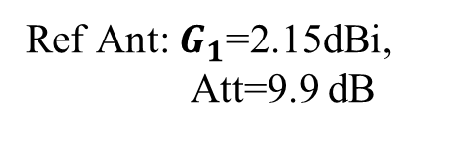


Confirming Power at the Receiving Side
Ref Ant: $G_{1}$=2.15dBi,
Att=9.9 dB
$$d=3.75m$$
$$P_{TX}$$
$$L_{path}$$
$$L_{C1}$$
Satellite
ICOM-9100 Radio
Variable Attenuations
Spectrum analyzer
$$P_{RX}$$
Satellite
1 | -98.2 dBm
2 | -90.5dBm
3 | -98.9 dBm
4 | -98.4 dBm
The UHF antennas for three satellites gave similar received power at the antenna
Maximum difference of 0.6dBm hence similar performance.
Satellite 2 antenna became lossy

Slide 25
Testing the Antenna Gain in UHF Uplink
Rx Antenna | Prx (dBm) | Antenna Gain
Ref Dipole Antenna with 9.9 dB attenuation | -55.7dBm | 2.15 dBi
BIRDS 5 Dipole Antenna Satellite 1 | -98.2 dBm | 1.45 dBi
$$G_{antenna}={P_{RX}−P_{TX}−G_{1}+L}_{path}+L_{C1}+L_{C2 }+Att$$
Measured and verified with Radio setup
SA: Noise floor= -120 dBm

Slide 26
Antenna Gain in UHF Downlink
From the radiation Pattern
Rx Antenna | Antenna Gain
Ref Dipole Antenna with 9.9 dB attenuation | 2.15 dBi
BIRDS 5 Dipole Antenna 1 | 1.9 dBi
BIRDS 5 Dipole Antenna 4 | 1.8 dBi
Measured and verified with SG setup
SA: Noise floor= -120 dBm

Slide 27
Received Power Measurements in Uplink (Setup Calibration)
Variable Attenuation(dB) | Effective Att (dB) | Expected Prx using SAT Antenna(dBm) | Measured Prx using Sat Antenna (dBm)
39 | -91.1 | -55.2 | -55.7
69 | -121.1 | -85.2 | -85.0
79 | -131.1 | -95.2 | -95.3
82 | -134.1 | -98.2 | -98.0
84 | -135.1 | -100.2 | -100.6
85 | -136.1 | -101.2 | -101.0

Slide 28

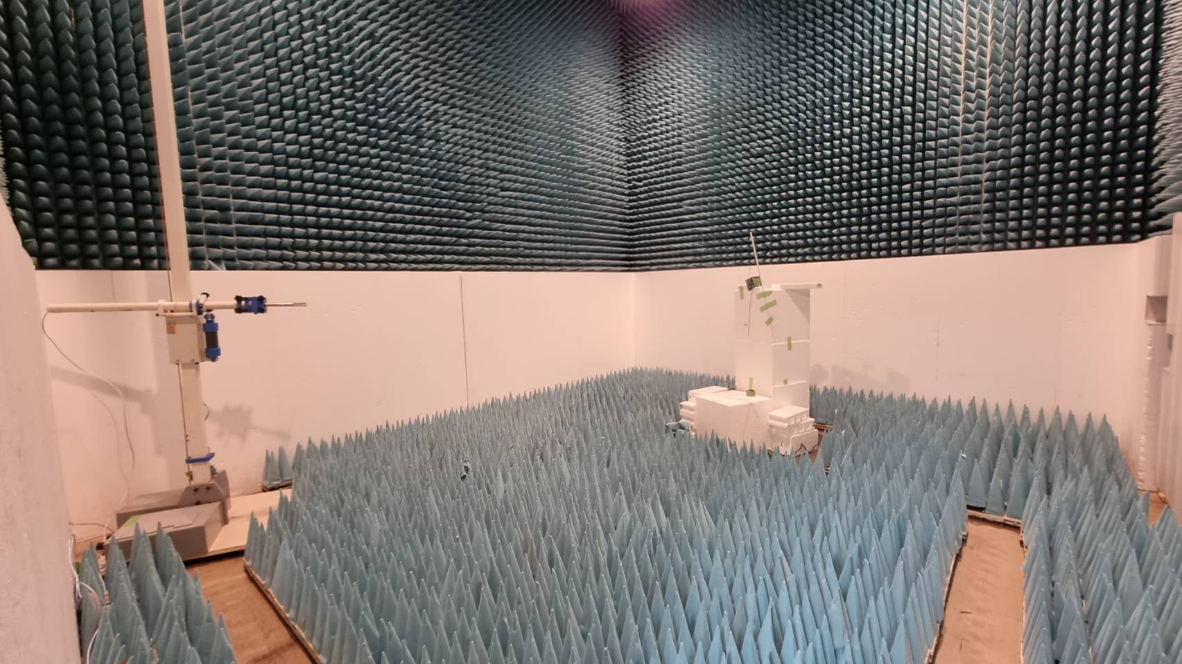
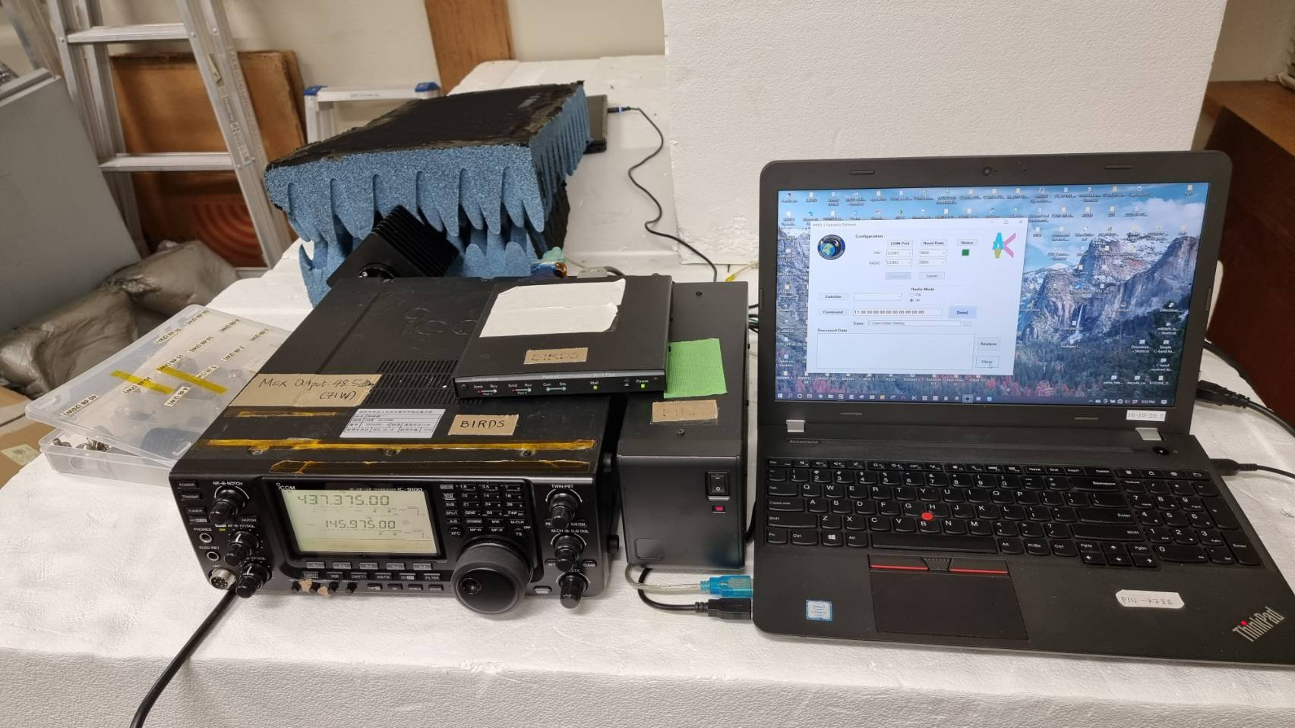
Measuring UHF TRX Sensitivity
UHF Dipole Antenna
47dBm
ICOM-9100 Radio
Variable Attenuators
Satellite
TNC

Slide 29

Measuring UHF TRX Sensitivity
Reference antenna
GS
Ground station Location
Door-2
Satellite
Anechoic chamber
Door-1
Door-3

Slide 30
Sensitive Testing UHF
Variable Attenuation(dB) | Effective Att (dB) | Expected Prx using SAT Antenna | Success Rate TRX1: New (Decoded) | Success Rate TRX2: BIRDS4 (Decoded) | Success Rate TRX3: BIRDS3 (Decoded) | Success Rate TRX4: 2UOnly (Decoded)
39 | -91.1 | -55.2 | 6/6 | 6/6 | 6/6 | 6/6
69 | -121.1 | -85.2 | 6/6 | 0/6 | 6/6 | 6/6
79 | -131.1 | -95.2 | 6/6 | 0/6 | 6/6 | 6/6
81 | -133.1 | -97.2 | 5/6 | 0/6 | 6/6 | 6/6
82 | -134.1 | -98.2 | 5/6 | 0/6 | 6/6 | 5/6
83 | -135.1 | -99.2 | 5/6 | 0/6 | 6/6 | 5/6
84 | -136.1 | -100.2 | 4/6 | 0/6 | 6/6 | 3/6
85 | -137.1 | -101.2 | 3/6 | 0/6 | 6/6 | 0/6
88 | -140.1 | -104.2 | 1/6 | 0/6 | 4/6 | 0/6
The test was repeated two different times and we verified the same results

Slide 31
Sensitivity of Satellite2: BIRDS4-TRX
Variable Attenuation(dB) | Effective Att (dB) | Expected Prx using SAT Antenna | Success Rate
 |  |  | Decoded | Received but not Decoded | Not Received
39 | -91.1 | -55.2 | 6/6 | 0/6 | ---
40 | -92.1 | -56.2 | -- | 6/6 | --
54 | -106.1 | -70.2 | -- | 5/6 | --
55 | -107.1 | -71.2 | -- | 4/6 | --
56 | -108.1 | -72.2 | -- | 4/6 | --
57 | -109.1 | -73.2 | -- |  | 6/6
BIRDS 4 Transceiver has very low Sensitivity

Slide 32
Comparison of BIRDS Sensitivity
BIRDS5
 | TRX1: New | TRX2: BIRDS4EM | TRX3: BIRDS3EM | TRX4: 2U
EM (dBm) | -- | -- | -103 | -101
FM (dBm) | -101.2 | -72 | -104.2 | -100.2

Slide 33
Test Conclusion for UHF TRX Sensitivity
Transceivers Tested | Uplink | Downlink | Overall Comment
Transceiver1: New | Good | Good | Good
Transceiver2: BIRDS4 | Good | Not Good | Not Good
Transceiver3: BIRDS3 | Good | Good | Good
Transceiver4: 2U Only | Good | Good | Good

Slide 34
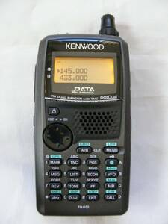



Calibration-VHF
Radio Transmission Output
$$P_{RX}=P_{TX}−Att=17.3dBm$$
Attenuator
Spectrum analyzer
TH-D72A Kenwood Radio
2. Cable Loss
$$L_{C}=3dB$$
$$L_{C}$$
Spectrum analyzer
TH-D72A Kenwood Radio

Slide 35
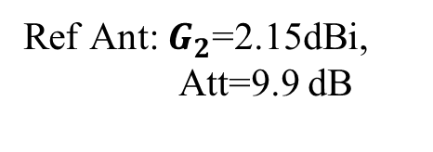

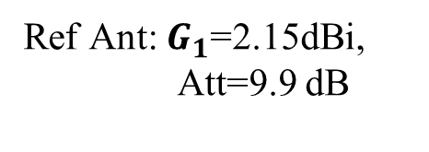



Determining the Path Loss
Practical Path Loss
Ref Ant: $G_{2}$=2.15dBi,
Att=9.9 dB
$$P_{TX}$$
Ref Ant: $G_{1}$=2.15dBi,
Att=9.9 dB
$$d=3.71m$$
$$L_{path}$$
$$L_{C2}$$
Variable Attenuators
$$L_{C1}$$
TH-D72A Kenwood Radio
$L_{path}=P_{TX}−L_{C1}−L_{C2 }−2∗Att+G_{1}+G_{2}−P_{RX}$ = 26.9dB
Spectrum analyzer
$$P_{RX}$$
2. Theoretical/Ideal Path Loss
$L_{path}=20 log\left(\frac{4πdf}{c}\right)$ = 27.1dB
Where: $f:VHF UP \& Downlink Freqs$, c: Speed of light, d: distance between the two antennas

Slide 36
Testing the Antenna Gain in VHF Uplink
Rx Antenna | Prx (dBm) | Antenna Gain
Ref Dipole Antenna with 9.9 dB attenuation | -55.7dBm | 2.15 dBi
BIRDS 5 Dipole Antenna Satellite 1 | -86.1 dBm | 1.5 dBi
$$G_{antenna}={P_{RX}−P_{TX}+L}_{path}−G_{1}+L_{C1}+L_{C2 }+Att$$
Measured and verified with Radio setup
SA: Noise floor= -120 dBm

Slide 37
Antenna Gain in VHF Downlink
From the radiation Pattern
Rx Antenna | Antenna Gain
Ref Dipole Antenna with 9.9 dB attenuation | 2.2 dBi
BIRDS 5 Dipole Antenna 1 | 1.4dBi
BIRDS 5 Dipole Antenna 4 | 1.6dBi
Measured and verified with Handheld Radio setup
SA: Noise floor= -120 dBm

Slide 38
Received Power Measurements in VHF Uplink (Setup Calibration)
Variable Attenuation(dB) | Effective Att (dB) | Expected Prx using SAT Antenna(dBm) | Measured Prx using Sat Antenna (dBm)
33 | -72.8 | -50.2 | -50.4
63 | -102.8 | -80.2 | -80.4
67 | -106.8 | -84.2 | -84.3
69 | -108.8 | -86.2 | -86.1
73 | -112.8 | -90.2 | -90.1

Slide 39
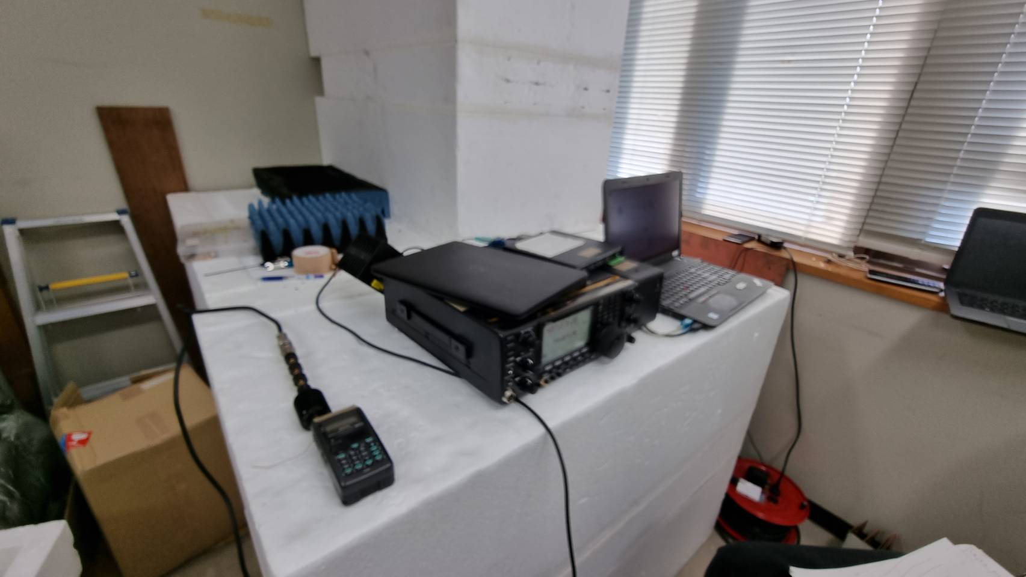
Measuring VHF TRX Sensitivity
Test Setup
UHF Dipole antenna
ICOM-9100 Radio
Attenuator
Satellite
Monopole Antenna
TNC
Variable Attenuators
TH-D72A Kenwood Radio

Slide 40
Sensitive Testing VHF
Var Att (dB) | Eff. Att (dB) | Ex Prx using SAT Ant | Succ Rate: CDR | SuccRate: B4 EM | Succ Rate: SAT1 | Succ Rate: SAT2 | SuccRate: SAT3 | Succ Rate: Sat4
69 |  | -86 | 4/4 | 4/4 | 4/4 | 4/4 | 4/4 | 4/4
70 |  | -87 | 3/4 | 1/4 | 4/4 | 4/4 | 4/4 | 4/4
71 |  | -88 | 0/4 | 0/4 | 4/4 | 4/4 | 4/4 | 4/4
73 |  | -90 | 0/4 | 0/4 | 4/4 | 4/4 | 4/4 | 4/4
75 |  | -92 | 0/4 | 0/4 | 4/4 | 4/4 | 4/4 | 4/4
79 |  | -96 | 0/4 | 0/4 | 4/4 | 4/4 | 4/4 | 4/4
80 |  | -97 | 0/4 | 0/4 | 4/4 | 4/4 | 4/4 | 0/4
81 |  | -98 | 0/4 | 0/4 | 4/4 | 4/4 | 4/4 | 0/4
82 |  | -99 | 0/4 | 0/4 | 0/4 | 0/4 | 0/4 | 0/4
83 |  | -100 | 0/4 |  | 4/4 | 4/4 | 4/4 | 4/4

Slide 41
Comparisons
 | Sat1 | Sat2 | Sat3 | Sat4 | CDR | BIRDS 4 EM
FM | 98 | 98 | 98 | 96
EM |  |  |  |  | 87 | 86

